Slide 1
Quiz from Last Week

Slide 2
Assignment from Last Week

Slide 3
Lecture 10
Graphs (Continued)

Slide 4
Searching a Graph
There are a few ways to traverse a graph
The two we’ll talk about are:
Breadth-first search (BFS)
Depth-first search (DFS)

Slide 5
Breadth-first Search
Traversal algorithm that visits a starting vertex, then all vertices of distance 1
It then visits all vertices of distance 2 and repeats outward without revisiting a vertex
Accomplishes this by using a “queue”

Slide 6
Breadth-first Search
The starting vertex is added to the queue
The algorithm pops a vertex from the queue and visits the popped vertex
Then, that vertex’s adjacent vertices are pushed into the queue (if they haven’t already been discovered)
This process repeats

Slide 7
Breadth-first Search
The vertices in the queue are called the frontier
These have been “discovered” but not yet visited
A vertex only needs to be visited once so an already-discovered vertex is not pushed to the queue again
A visit may mean to print the vertex, compare it to a value, etc.

Slide 8
Depth-first Search
A depth-first search (DFS) is a traversal that visits a starting vertex, then visits every vertex along each available path until it reaches the end.
A stack is used for this algorithm

Slide 9
Depth-first Search
The starting vertex is pushed onto a stack
The algorithm pops a vertex from the top of the stack
If the vertex has not already been visited, the algorithm visits the vertex and pushes the adjacent vertices to the stack

Slide 10
Depth-first Search
A depth-first search can also be accomplished through recursion using the call stack
The algorithm is first called with the starting vertex
Visit the vertex and then perform a recursive DFS call for each adjacent vertex

Slide 11
Example
https://www.youtube.com/watch?v=bIA8HEEUxZI

Slide 12
Finding the Shortest Path
Finding the shortest path between vertices in a graph has many applications
Find the shortest traffic route between two intersections
Find the fastest travel time (using travel time as edge weights)

Slide 13
Dijkstra’s Shortest Path Algorithm
Created by Edsger Dijkstra
Determines the shortest path from a start vertex to each vertex in a graph

Slide 14
Dijkstra’s Algorithm
Terminology
A vertex’s distance is the shortest path to it from the start vertex
A vertex’s predecessor pointer points to the previous vertex along the shortest path from the start vertex
In Zybooks, they use the term ‘queue’ to describe the list of vertices not yet visited
It is NOT the same as the Queue data structure we have previously learned about

Slide 15
Dijkstra’s Algorithm
Initial Actions:
Initialize all vertices’ distances to infinity
Initialize all vertices’ predecessors to zero
Push all vertices to a list of unvisited vertices
Assign the start vertex’s distance as zero

Slide 16
Dijkstra’s Algorithm
Steps (continued):
The vertex with the shortest distance is popped from the list
For each adjacent vertex, compute the distance of the path from the start vertex to the current vertex and continue on to the adjacent vertex
If that path’s distance is shorter than the adjacent vertex’s current distance, a shorter path has been found

Slide 17
Dijkstra’s Algorithm
Steps (Continued):
The adjacent vertex’s current distance is updated to the newly found shortest path
The adjacent vertex’s predecessor pointer is pointed to the current vertex

Slide 18
Dijkstra’s Algorithm
After running the algorithm, the shortest path from the start vertex to a destination vertex can be determined using the vertices’ predecessor pointers
If the destination’s predecessor pointer is not zero, the shortest path is followed in reverse through the predecessor pointers until reaching the start vertex
Else, a path from the destination to start does not exist

Slide 19
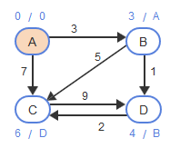
Dijkstra’s Algorithm

Slide 20
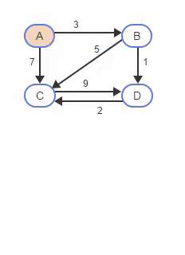

Slide 21
Dijkstra Performance
If the unvisited vertex “queue” is implemented using a list
The algorithm runtime is O(V²)
The outer loop executes V times to visit all vertices
Each popping operation requires searching all vertices in the list O(V)

Slide 22
Dijkstra Performance
Implementing the queue using a heap data structure reduces the runtime to O(E + Vlog(V))
This algorithm can be used for unweighted graphs and weighted graphs with non-negative edge weights
Results are unreliable with negative edge weights

Slide 23
Break

Slide 24
Bellman-Ford’s Shortest Path
This algorithm performs V-1 main iterations, visiting all vertices in the graph during each iteration
Each time a vertex is visited, the algorithm follows all edges to adjacent vertices

Slide 25
Bellman-Ford’s Shortest Path
This algorithm does not require a specific order for visiting vertices during each main iteration
So after each iteration, a vertex’s current distance and predecessor may not yet be the shortest path from the start vertex

Slide 26
Bellman-Ford’s Shortest Path
The shortest path may propagate to only one vertex each iteration
Requires V-1 iterations to propagate from the start vertex to all other vertices

Slide 27
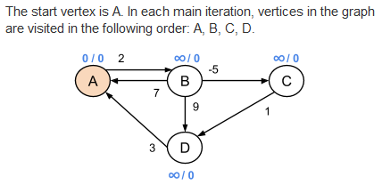
Bellman-Ford Example

Slide 28
Bellman-Ford Performance
The runtime is O(VE)
E is total of edges
There are V-1 outer loop iterations
In each outer loop execution, the algorithm visits each vertex and follows the subset of edges to adjacent vertices

Slide 29
Bellman-Ford Negative Edges
Supports graphs with negative edge weights
As long as no negative edge weight cycle exists
The algorithm checks for negative edge weight cycles after visiting all vertices V-1 times

Slide 30
Bellman-Ford Negative Edges
How does it determine if a negative cycle exists?
After the algorithm has visited all vertices V-1 times, we should be guaranteed to have determined the shortest paths for all vertices
If we visit all the vertices one more time and any of their distances decrease, then a negative cycle must exist

Slide 31
Dijkstra vs. Bellman-Ford
Dijkstra is faster but doesn’t work with negative edge weights
Faster because it visits each vertex only once and can use a heap for the vertex queue to increase performance
Bellman-Ford is a slower brute force methodology but it works with negative edge weights
It can also detect negative edge weight cycles

Slide 32
Quiz this Week
Topic: Graph Searching and Shortest Path

Slide 33
Assignment this Week
Graph Searching

Slide 34
Zybooks Sections for Today
5.5, 5.6, 5.9, 5.10

